Slide 1
Issue Workflow Explorer
Jiaxin Zhu¹， Zhen Zhong² and Minghui Zhou²
¹Institute of Software, Chinese Academy of Sciences
²Peking University

Slide 2

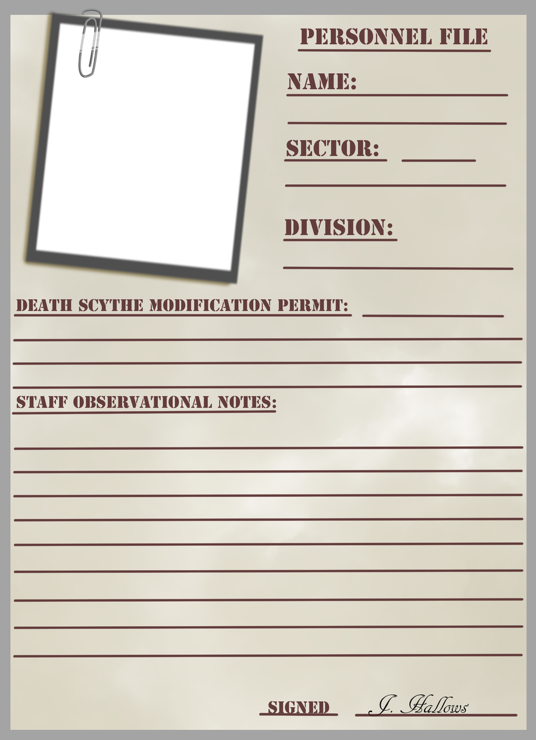



Issue Workflow
Resolved
issue report：
bug/feature request
some kind of workflow
issue tracker, e.g.,
reporter
issue tracking data
developers

Slide 3
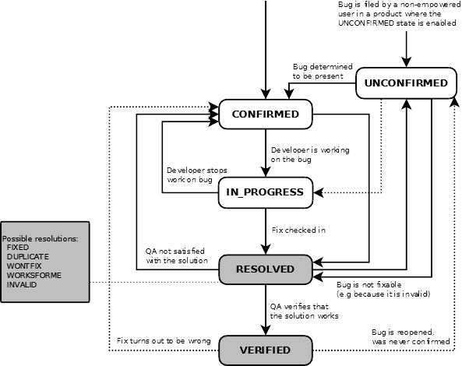
Bugzilla Issue Workflow
The amount of new issue reports can be large (>1k/mon.).
The issues are various.
The experience of reporters is various.
Does it work well?
One does not fit all.
The workflow is often customized.

Slide 4
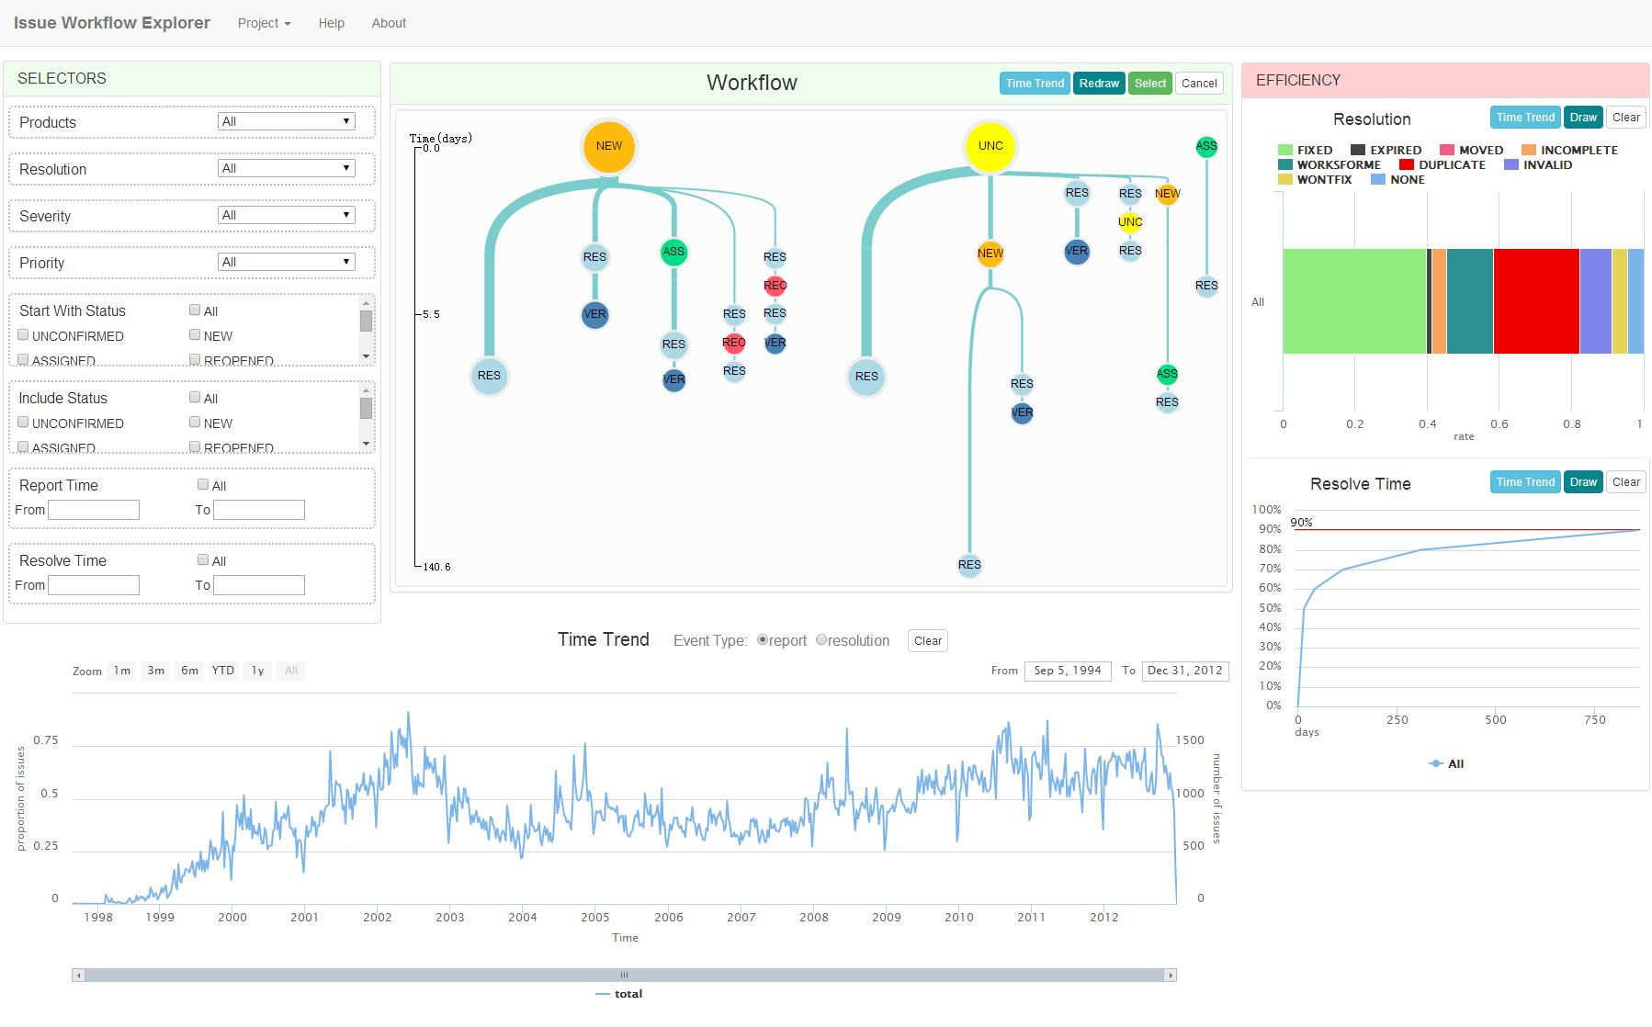
Issue Workflow Explorer（IWE）
Choose reports to observe.
Check the workflows.
Check the workload and throughput.
Check the efficiency.

Slide 5
Customizable Measures
Workload
# of new reports per time unit
Throughput
# of resolved reports per time unit
Efficiency
Input-output ratio: proportion of reports with resolution R
Latency: proportion of reports change to status S within time T

Slide 6


Empirical Evaluation
We evaluate IWE through conducting an empirical study using it.
Can IWE help users discover previous workflows in practice, evaluate their efficiency and get insights for improvement?
We study two project, GNOME and Mozilla (477K and 679K issues reports submitted in over 10 years).
RQ1: What manners are there for issue triage and what are their strength and weakness on issue resolution efficiency?
RQ2: What strategies are there for handling incomplete issue reports, and what are the advantages and disadvantages?

Slide 7
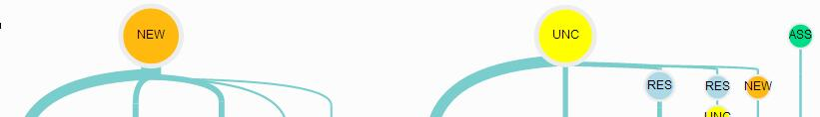
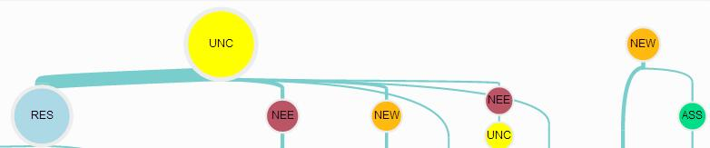
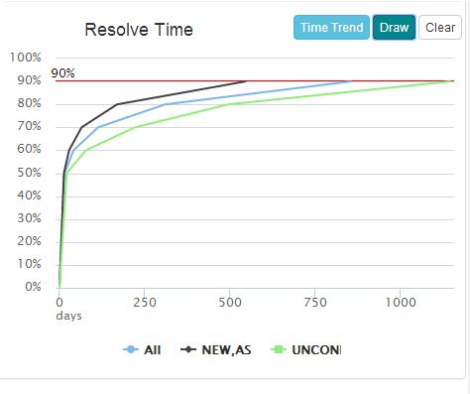
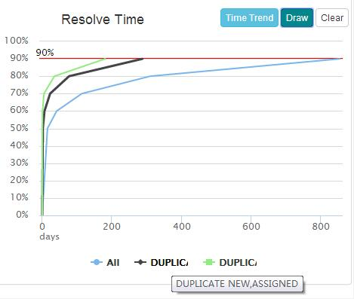
Issue Triage
Workflow discovery
public and private triage
Mozilla
GNOME
Workflow evaluation
private triage has lower latency
public triage can reveal low quality reports faster
Mozilla

Slide 8
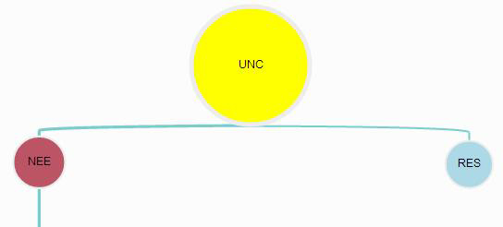
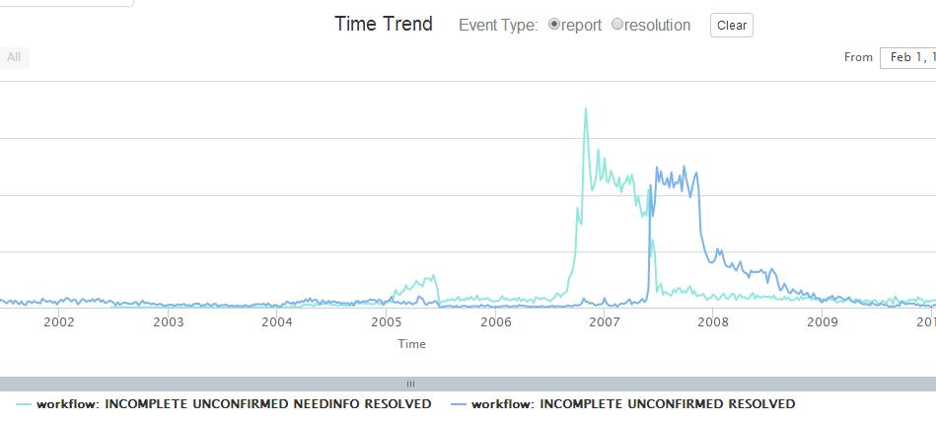
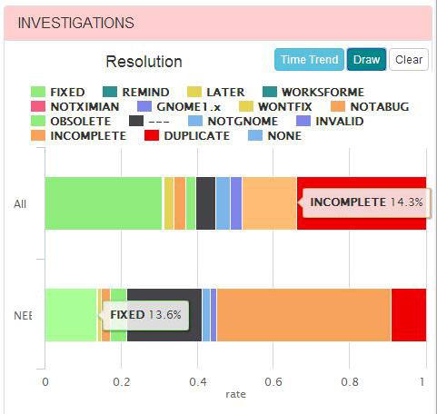
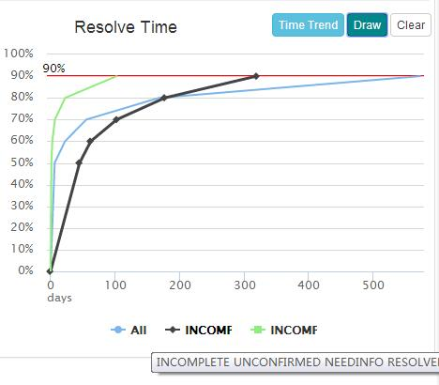
Handling of Incomplete Reports
Workflow discovery
Mozilla
Workflow evaluation
Skipping NEEDINFO has lower latency
NEEDINFO does not help to make report complete

Slide 9
Summary
We build IWE to support exploring issue workflow.
It has customizable and visualized measures.
Our empirical study shows that IWE makes it easy to discover and evaluate workflows.
Have a try:
https://github.com/johnarseal/IWE

Slide 10
Thank you！

